Slide 1



Agriculture and Climate Change: Challenges and Solutions for Our Future
The relationshipbetweenagriculture andclimate has sustainedhumanityfor millennia,
but todaythisdelicate balancefaces unprecedented challenges. As our planet's climate rapidly transforms, the agricultural systems that feed nearly 8 billion people must evolve or
face catastrophic consequences. This presentation explores the critical intersection of
climate change and food production, examining both the severe threats and innovative
solutions that will shape our agricultural future.

Slide 2
Climate Change: The Greatest Threat to Global Agriculture
Rising Temperatures
Shifting Rainfall Patterns
Precipitation patterns arebecoming increasingly unpredictable, creating droughts in some regions while causing floods in
others.
ExtremeWeather Events
Global averagetemperatureshave increased by 1.1°C since pre-industrial times, disrupting traditional growing seasons and crop cycles
worldwide.
Hurricanes,hailstorms,andunexpected
frosts are becoming more frequent and severe, devastating crops and livestock
operations.
The evidence is undeniable: climate change represents an existential threat to global food security. Since 2020, the U.S. Southwest has endured the worst
drought in 1,200 years, forcing farmers to abandon fields and threatening the livelihoods of entire agricultural communities. Meanwhile, wildfires increasingly
consume farmlands and rangelands, with toxic smoke compromising both human health and agricultural productivity across vast regions.

Slide 3

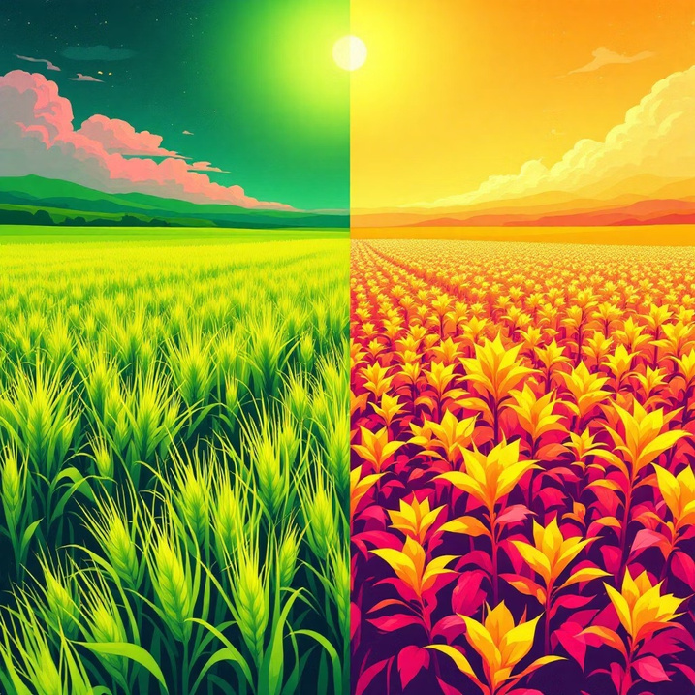
Impact on Crop Yields and Food Security
Declining Yields Despite Longer Seasons
While some regions experience extended growing periods, the net effect on major staple crops remains negative. Corn, rice, wheat, and oats face significant yield reductions due to heat stress, water scarcity, and increased pest pressure.
Ozone Pollution's Hidden Impact
Ground-level ozone, exacerbated by rising temperatures, interferes with photosynthesis4the fundamental process that powers plant growth. This pollution slows development and makes crops more susceptible to diseases and pests.
Critical projection: By 2050, global crop yields could plummet by up to 25% under high-emission climate scenarios without immediate adaptation measures.
The mathematics of global food security are stark. With world population projected to reach 9.7 billion by 2050, we need to increase food production by 70% just to meet demand. Yet climate change is pushing yields in the opposite direction, creating a dangerous gap that threatens to leave hundreds of millions without adequate nutrition.

Slide 4
Heat Stress and Livestock Vulnerability
$1.2B
Economic Loss
heat stress in 2010 alone, demonstrating the massive economic impact of rising temperatures.
15%
Milk Production Drop
Averagereductionin milkyieldwhendairy cows experience heat stress above their comfort zone of 68-77°F.
30%
Appetite Reduction
Estimated losses in theU.S. dairy sector from
Decrease in feedintake whencattle face prolonged high temperatures, leading to weight loss and reduced productivity.
Livestock agriculture faces a perfect storm of climate-related challenges. Dairy cows, naturally adapted to cooler climates, suffer tremendously from heat
stress, reducing both their appetite and milk production capacity. Rising temperatures also create ideal conditions for livestock diseases to flourish while
simultaneously degrading pasture quality, forcing farmers to purchase expensive supplemental feed. The ripple effects extend beyond immediate production losses. Heat-stressed animals have compromised immune systems, require more veterinary care,
and have reduced reproductive success4threatening the long-term sustainability of livestock operations across the globe.

Slide 5
Soil and Water Challenges
Intensified Soil Erosion
Climate change brings morefrequent and
Water Scarcity and Flooding Extremes
Groundwater Depletion Crisis
Assurfacewaterbecomes lessreliable,
intense rainfall events, washing away precious topsoil that took centuries to
form. This erosion strips away the nutrients
essential for crop growth and threatens
the foundation of sustainable agriculture.
Shiftingprecipitation patternscreatea cruel paradox: some regions face severe
droughts while others experience
devastating floods. Both extremes disrupt
planting schedules, damage crops, and
strain agricultural infrastructure.
farmers increasingly rely on underground aquifers. However, these ancient water
sources are being depleted faster than
they can naturally recharge, threatening
future agricultural viability.
Water and soil represent the fundamental building blocks of agriculture, yet both face unprecedented threats from our changing climate. The challenge
extends beyond immediate crop losses4we're witnessing the degradation of resources that underpin our entire food system. Efficient water management
and aggressive soil conservation have evolved from best practices to urgent survival strategies for farmers worldwide.

Slide 6
Climate-Smart Agriculture: A Path Forward
TheFoodandAgriculture Organization(FAO)defines climate-smartagricultureasan integrated approachthat transformsagricultural systemsto
sustainably increase productivity, enhance resilience to climate change, and reduce greenhouse gas emissions wherever possible. This revolutionary framework offers hope in our fight against climate challenges.
Crop Rotation Systems
Agroforestry Integration
Conservation Agriculture
Strategic rotation of different crops improves soil health, breaks pest cycles, and optimizes nutrient use. Legumes in rotation naturally fix nitrogen, reducing the need for synthetic fertilizers.
Combining trees with crops and livestock creates resilient farming systems that sequester carbon, provide shade, prevent erosion, and offer multiple income streams for farmers.
Minimal soil disturbance, permanent soil cover, and diversified cropping systems work together to rebuild soil health, retain moisture, and reduce erosion.
Climate-smart agriculture represents more than just adaptation4it's a transformation toward regenerative practices that can help meet the projected 60%
increase in global food production needed by 2050 while simultaneously addressing climate challenges.

Slide 7

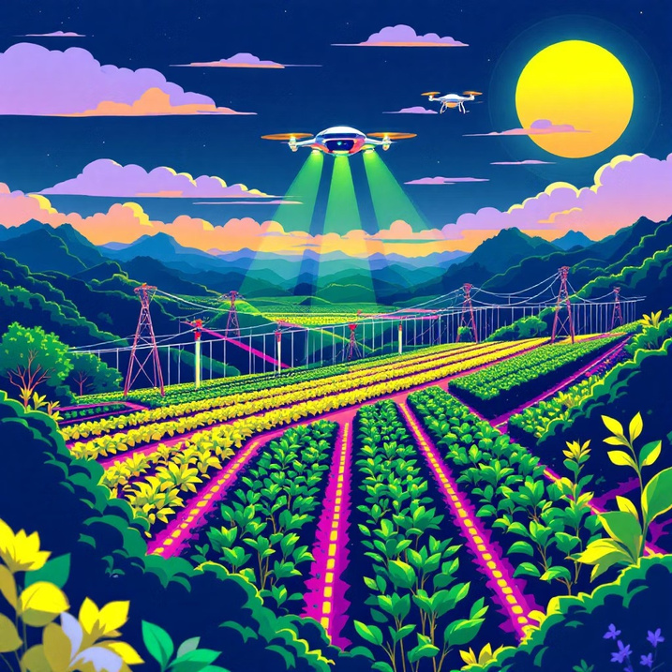
Innovative Technologies and Practices
01
Heat and Drought-Tolerant Varieties
Advanced breeding programs and genetic research are developing crop varieties that can withstand higher temperatures and longer periods without water, ensuring stable yields even under extreme conditions.
02
Precision Irrigation Systems
Smart irrigation technologies use sensors, weather data, and satellite imagery to deliver exactly the right amount of water at the optimal time, reducing waste by up to 30% while maintaining crop health.
03
Integrated Pest Management
04
Improved Livestock Feeding
Optimized feed formulations and feeding schedules reduce methane emissions while improving animal health and productivity, creating win-win outcomes for farmers and the environment.
Holistic approaches combining biological controls, resistant varieties, and targeted treatments reduce chemical inputs while building ecosystem resilience against climate-driven pest outbreaks.
Innovation drives agricultural resilience. Modern precision agriculture combines satellite monitoring, drone surveillance, and artificial intelligence to optimize every aspect of farming. These technologies enable farmers to make data-driven decisions that maximize productivity while minimizing environmental impact.

Slide 8


Global and Local Adaptation Efforts
South Asian Initiatives
Countries like India andBangladesh are implementing climate-resilient rice varieties and early warning systems to help farmers adapt to changing monsoon patterns and extreme weather events.
African Innovation Hubs
Latin American Programs
Kenya,Ghana,andother nationsare developing drought-resistant crops and promoting conservation agriculture techniques that work within traditional farming systems while building climate resilience.
Countries fromMexicoto Argentinaare
investing in climate-smart coffee, cocoa, and grain production systems that maintain productivity while reducing emissions.
Success in climate adaptation requires both global coordination and local innovation. Farmer-to-farmer exchanges share practical knowledge across
borders, while locally tailored climate forecasting systems empower communities to optimize planting and harvesting decisions. International climate funds
provide crucial support for adaptation projects in the world's most vulnerable agricultural regions. These collaborative efforts recognize that climate change affects everyone, but impacts fall disproportionately on smallholder farmers who produce much
of the world's food yet have the least resources to adapt.

Slide 9


The Role of Policy and Investment
Livestock
Crop Production
Land Use Change
Other Sectors
Agriculture accounts for approximately 30% of global greenhouse gas emissions, making it both a victim and contributor to climate change. This dual role
creates unique challenges and opportunities for policymakers who must balance competing priorities.
1
2
3
Food Security
Rural Development
Emission Reductions
Ensuring adequate, affordable nutrition for growing populations while adapting to climate impacts.
Supporting farmer livelihoods and rural communities through economic transitions and climate adaptation.
Implementing practices that reduce agricultural contributions to greenhouse gas emissions.
Strategic investment in agricultural research, climate-resilient infrastructure, and farmer education represents one of the highest-return strategies for
addressing climate change. Every dollar invested in agricultural adaptation can yield $3-7 in avoided losses and increased productivity, making this not just
an environmental imperative but an economic opportunity.

Slide 10


Farmers at the Frontline: Vulnerability to Climate Change
Farmers, especiallysmallholders,areuniquelyexposed totheacceleratingimpactsofclimatechange.Theirlivelihoodsareintrinsicallylinkedtonatural
systems that are becoming increasingly unpredictable, leading to a cascade of challenges.
Economic Instability
Limited Adaptation Resources
High Weather Dependency
Extreme weather events like droughts, floods, and heatwaves lead to crop failures, livestock losses, and significant income reduction, pushing many farming households into poverty.
Many farmers, particularly in developing regions, lack the financial capital, access to advanced technologies, or knowledge needed to implement climate-resilient farming practices.
Agriculture is inherently reliant on stable weather patterns. Shifts in rainfall, temperature extremes, and altered growing seasons directly threaten traditional farming methods and yields.
Insufficient Support Systems
Smallholder Vulnerability
Access to modern agricultural technologies (e.g., drought-resistant seeds, efficient irrigation) and climate insurance schemes remains limited for many, leaving them exposed to climate shocks.
Smallholder farmers, who produce a significant portion of the world's food, are often the most marginalized and have the fewest safety nets, making them highly susceptible to climate-
induced poverty and displacement.

Slide 11
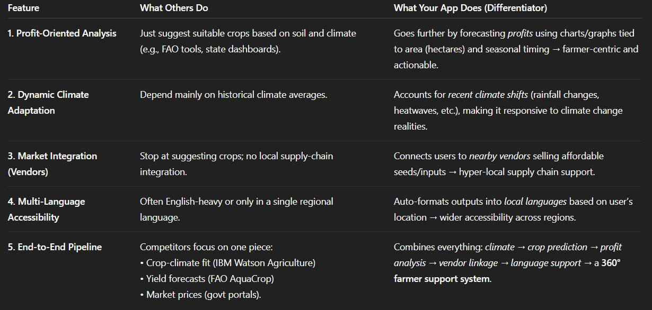

Slide 12
Economic Imperative: Costs and Benefits
Climate change posesasignificantfinancialthreatto globalagriculture,butinvestinginclimate-smartsolutionsofferssubstantialeconomicreturns.The
costs of inaction far outweigh the investments needed for adaptation and resilience.
$100B
Annual Losses
$50B
Adaptation Costs
7x ROI
Investment Return
Estimated average annual financial losses in
Projected annual investment required globally to
Every dollar invested in climate-smart agriculture can yield up to $7 in avoided losses and increased productivity.
agriculture due to climate change impacts like droughts, floods, and extreme weather events.
help farmers adapt to changing climate conditions and implement sustainable practices.
These figures highlight a clear economic imperative: proactive investment in climate-smart agriculture is not just an environmental necessity, but a
financially sound strategy to secure global food systems and foster economic stability in rural communities.

Slide 13


Our Technological Approach
Ourteamhas developedan innovativeAIsystemthat canpredictthecrop withmaximumyield potentialfor anygiven regionand timeofyear based on
user-specified parameters. This cutting-edge solution leverages advanced artificial intelligence and machine learning concepts to revolutionize agricultural decision-making.
Key AI and ML Concepts Behind Our Project:
Machine Learning Algorithms
Our system uses supervised learning models trained on vast datasets of historical crop yields, weather patterns, soil conditions, and regional agricultural data to identify optimal crop-location-timing combinations.
Predictive Analytics
Advanced regression models and ensemble methods analyze multiple variables simultaneously - including temperature patterns, precipitation forecasts, soil composition, and seasonal trends - to generate accurate yield predictions.
Neural Networks
Deep learning architectures process complex, non-linear relationships between environmental factors and crop performance, enabling our AI to recognize subtle patterns that traditional analysis might miss.
Feature Engineering
Our system automatically identifies and weighs the most important factors affecting crop yields in specific regions, from micro-climate conditions to soil nutrient levels.
Real-time Data Integration
The AI continuously incorporates current weather data, satellite imagery, and local agricultural reports to refine predictions and adapt to changing conditions.
This technological approach empowers farmers and agricultural planners to make data-driven decisions that maximize productivity while minimizing risk,
representing a significant advancement in precision agriculture.

Slide 14
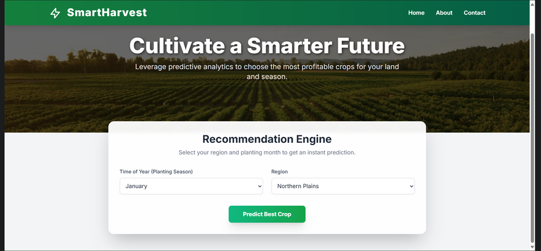
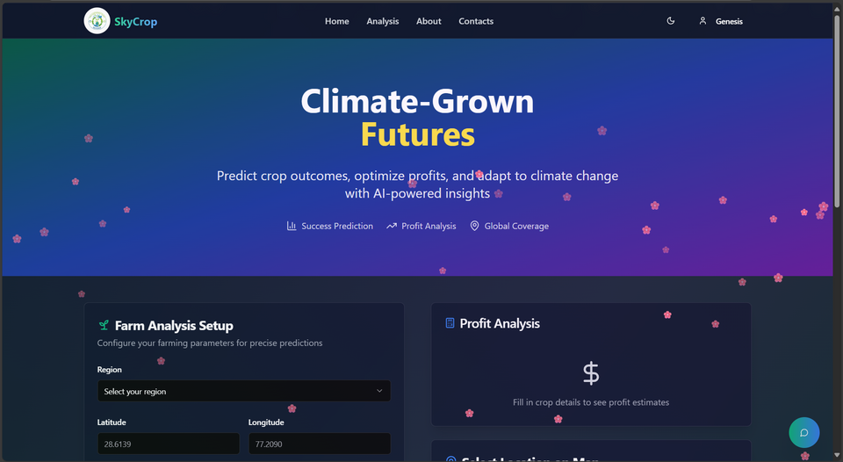
BEFORE
AFTER

Slide 15

Conclusion: Securing Agriculture's Future in a Changing Climate
The Challenge is Unprecedented
Climatechangeposesthegreatestthreatagriculturehaseverfaced,withrisingtemperatures,shiftingweatherpatterns,andextreme events disrupting food
But So Is Our
Opportunity
systems worldwide. The stakes could not be higher4global food security hangs in the balance.
Innovationinclimate-smartagriculture,precisionfarmingtechnologies,andresilientcropvarietiesofferspathwaystonotjustsurvive but thrive in a
changing climate. We possess the knowledge and tools needed to transform our food systems.
Farmers Leading Innovation
Scientists Developing Solutions
Policymakers Enabling Change
Agricultural producers worldwide are adopting climate-smart practices that increase resilience while maintaining
productivity and profitability.
Governments and international organizations are investing in climate adaptation and creating policies that
support agricultural transformation.
Research institutions are creating drought-tolerant crops, precision
technologies, and sustainable practices that address climate challenges.
"By embracing climate-smart solutions today, we can ensure food security and sustainable livelihoods for generations to come. The future of agriculture
4and humanity itself4depends on our collective action in this critical decade."

